Slide 1


Employee Attrition Analysis
Tools Used: SQL | Python | Power BI
Presented By: Roshini Yelisetti

Slide 2
Problem Statement
Organizations face challenges in retaining employees and reducing attrition.
The objective of this project is to analyze employee data to identify the major factors influencing attrition and provide insights that help improve employee retention and workforce planning.

Slide 3
Project Objectives
• Analyze employee attrition trends
• Identify departments with higher attrition
• Analyze job role-wise attrition
• Study employee demographics
• Understand salary and job satisfaction impact
• Build an interactive HR analytics dashboard

Slide 4
Tools & Technologies
SQL
• Data extraction
• Aggregation
• Analysis
Python
• Data Cleaning
• Exploratory Data Analysis
• Visualization
Power BI
• Dashboard Design
• DAX Measures
• Interactive Visualizations

Slide 5
SQL & Python Analysis
SQL Analysis
• Employee Distribution
• Department Analysis
• Attrition Analysis
• Salary Analysis
• Job Role Analysis
Python Analysis
• Data Cleaning
• Missing Value Handling
• Exploratory Data Analysis
• Charts and Visualizations

Slide 6
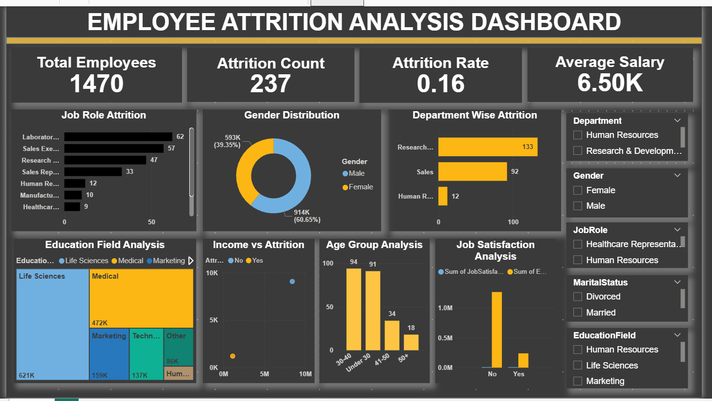
Power BI Dashboard
The dashboard provides a comprehensive overview of employee attrition across departments, job roles, salary levels, education fields, and demographic groups.
Interactive slicers enable users to analyze employee data based on multiple filters, helping HR managers identify patterns and make informed workforce decisions.

Slide 7
Dashboard Components
KPI Cards
• Total Employees
• Attrition Count
• Attrition Rate
• Average Salary
Charts
• Job Role Attrition
• Gender Distribution
• Department-wise Attrition
• Education Field Analysis
• Income vs Attrition
• Age Group Analysis
• Job Satisfaction Analysis
Interactive Filters
• Department
• Gender
• Job Role
• Marital Status
• Education Field

Slide 8
Key Insights
• Research & Development department recorded the highest attrition.
• Sales department showed the second-highest attrition.
• Employees aged 30–40 formed the largest workforce segment.
• Employees with lower salaries showed relatively higher attrition.
• Job satisfaction plays an important role in employee retention.
• Certain job roles experienced significantly higher employee turnover.

Slide 9
Business Recommendations
• Improve employee engagement programs.
• Focus on high-attrition departments.
• Introduce competitive salary and benefits.
• Conduct regular employee satisfaction surveys.
• Strengthen career development and training opportunities.
• Monitor attrition trends using interactive dashboards.

Slide 10
Conclusion
This project successfully transformed HR data into actionable business insights using SQL, Python, and Power BI.
The interactive dashboard enables HR professionals to monitor employee attrition, identify key risk factors, and support strategic workforce planning through data-driven decisions.

